Slide 1

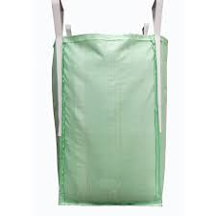
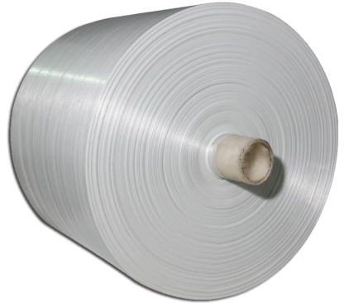
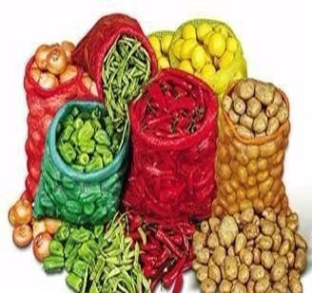

Disha Jute & Allied Products (P) Ltd.
Leveraging on our long period of market experience, We, Disha Jute & Allied Products Private Limited have made ourselves known as a most reliable Manufacturer, Exporter and Supplier of FIBC, PP Woven Fabric & Bags.
We have invested our reach Experience of about 35 years in building our Products not less than the Perfect. Our entire Product range is developed with utmost dedication by our experts and professionals, following the world class quality norms laid down by the industry. Moreover, we have mustered a huge clientele due to our ability to meet even the most immediate or high quantity requirements in less time period.

Slide 2
OUR PRODUCTRANGE

Slide 3
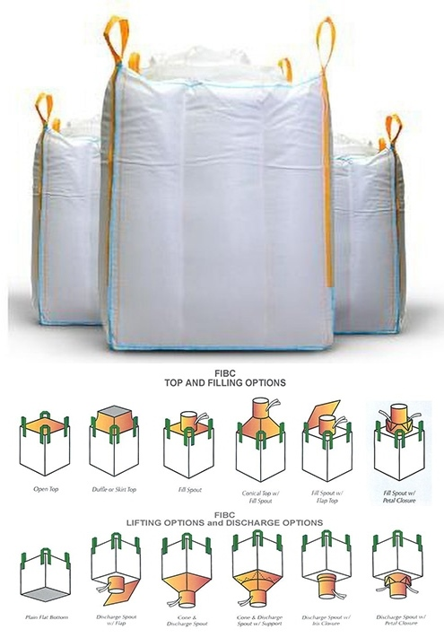
PP Woven FIBC Jumbo Bags

Slide 4
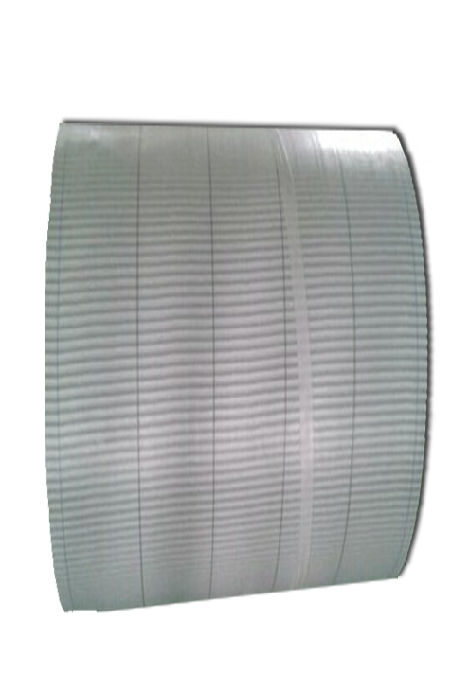
PP Woven Fabric for FIBC

Slide 5
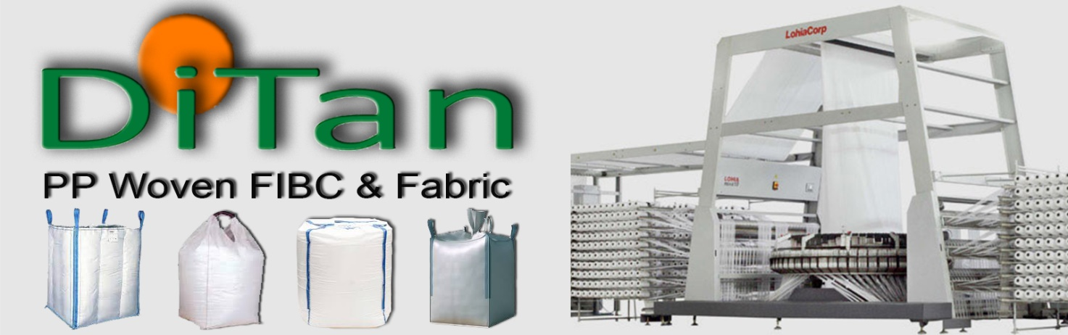
PP Woven FIBC & Fabric
FIBC with skirt and discharge spout can be offered in different sizes to suit customer needs. FIBC can be made with coated fabrics on one side or coated on both sides. For products that are sharp where maximum density is a requirement, we can produce a FIBC with two layers. We can also offer FIBC with inner bag of LDPE. Our FIBC can be manufactured with dustproof seams according to customer demands. We can produce different types of FIBC approx. 220 MT / 1,00,000 Jumbo Bags per month.
Application:
Food
:
Hygienic bulk bag designed for food industries with the most stringent standards.
Agriculture
:
Food safe storage and transport for your agriculture needs.
Chemicals
:
Dangerous chemicals can pose many issues.
Resin
:
High quality solutions for transporting and storing resin material.
Mining
:
No matter what material you are mining, our bags are built to last in and storage transport.
Construction
:
Our custom bag solutions are rigorously tested for and, gravel and aggregate needs.

Slide 6
Quality Management System
Our Quality Management System is a scientific and systematic. This department is equipped with equipment like Test Rig designed in accordance with the ISO Standards to conduct load tests on FIBCs, Tensile Testing machine to measure the strength and elongation of the fabrics, webbing, sewing yarns and seams and U.V accelerated weathering machines to measure UV retention as per ISO Standard. The staff involved in the quality management team has a sufficient level of knowledge, experience and information about standards appertaining to FIBC matters. Please find the list of equipment’s used by our Quality team to provide flawless product to our customers.
Lab Equipments
Sr. | Machine Description | Qty
1 | Shrinkage Chamber | 1
2 | Hot Air Oven | 1
3 | Humidity Chamber | 1
4 | Tensile Tester 3 in 1 ( Belt /Tape/Fabric ) | 1
5 | Denier Testing Machine – Warp Reel | 1
6 | Melt Flow Index Tester | 1
7 | Muffle Furnace | 1
8 | Desiccator | 1
9 | Micro Meter | 1
10 | Weighing Scale (0.1 Gms. to 200 Gms.) | 1
11 | Weighing Scale (200 Mgs to 600 Gms) | 1
12 | Weighing Scale (40 Gms. to 20 Kg.) | 1
13 | Load Testing Rig | 1
14 | Inspection Tables | 4

Slide 7

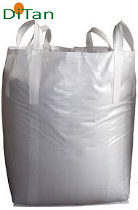

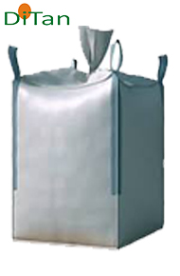

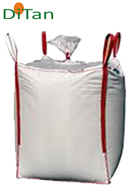
Types of Bags
Circular Bags
4 Panel Bags
U Panel Bags

Slide 8

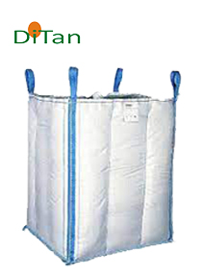
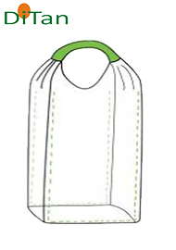
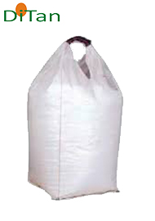
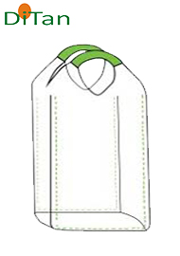
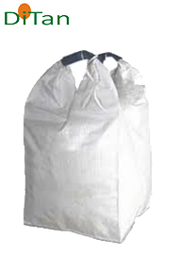
Baffle Bags
One Loop Bag
Two Loop Bag

Slide 9
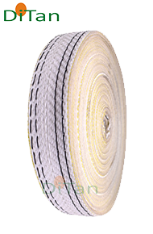
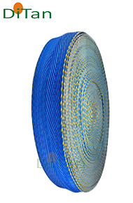
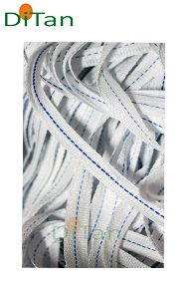
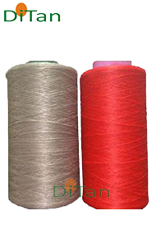
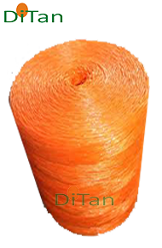
Webbing
Ties
Fibrillated Yarn

Slide 10
Machinery Installed for FIBC
Sr. | Machine Description | Nos
1 | Tape Plant - Lorex 1600 HS (600 KG/Hour) | 1
2 | Cheese Winders attached | 284
3 | Lamination Plant | 1
4 | Circular Loom - LSL 620 | 4
5 | Circular Loom - NOVA 620 | 10
6 | Circular Loom - NOVA 82 | 4
7 | Needle Loom 50 MM - 6 Head | 1
8 | Needle Loom 75 MM - 4 Head | 3
9 | Needle Loom 100 MM - 2 Head | 1
10 | Needle Loom 30 MM - 2 Head | 1
11 | Twisting Machine - 24 Spindle | 1
12 | Automatic Fabric Cutting Machine | 2
13 | Automatic Belt Cutting Machine | 1
14 | Baffle Punching Machine | 1
15 | Round Punching Machine | 1
16 | Printing Machine 4 Colours | 1
17 | Printing Machine 5 Colours | 1
18 | Bag Cleaning Machine | 1
19 | Stitching Machine - Heracle | 6
20 | Stitching Machine - VMC | 6
21 | Stitching Machine - DDR 603 | 6
22 | Stitching Machine - LU – 1510-N | 24
23 | Inspection Tables | 4
24 | UV Weatherometer | 1
25 | Hydraulic Baling Press Machine (150 Ton) 95 x 115 cm | 1
26 | Air Compressor with Dryer | 1
27 | D. G. Set | 2

Slide 11
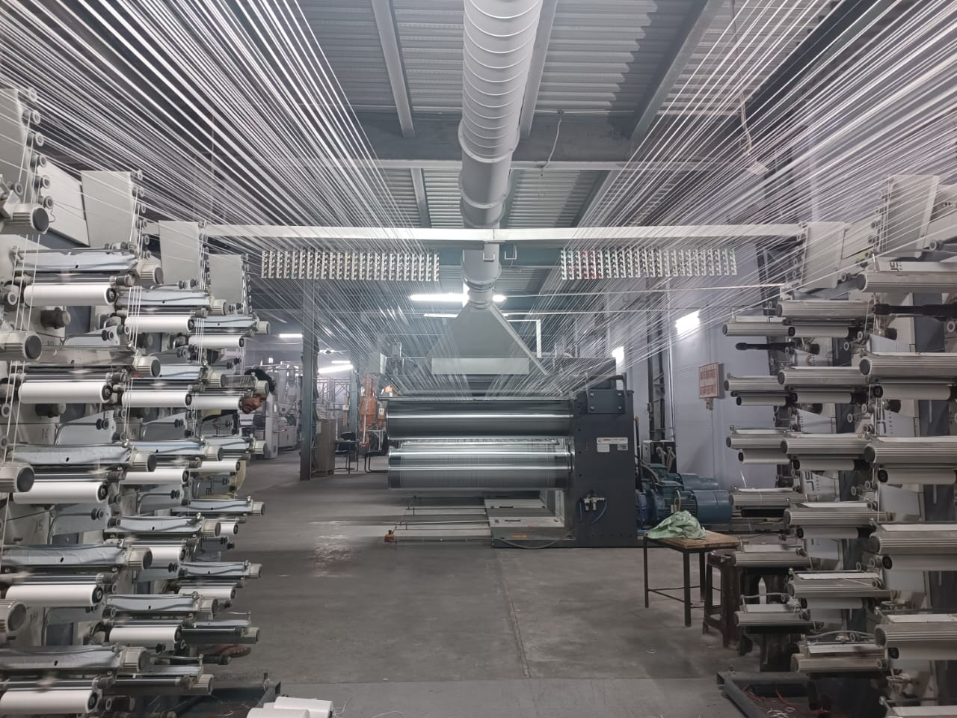
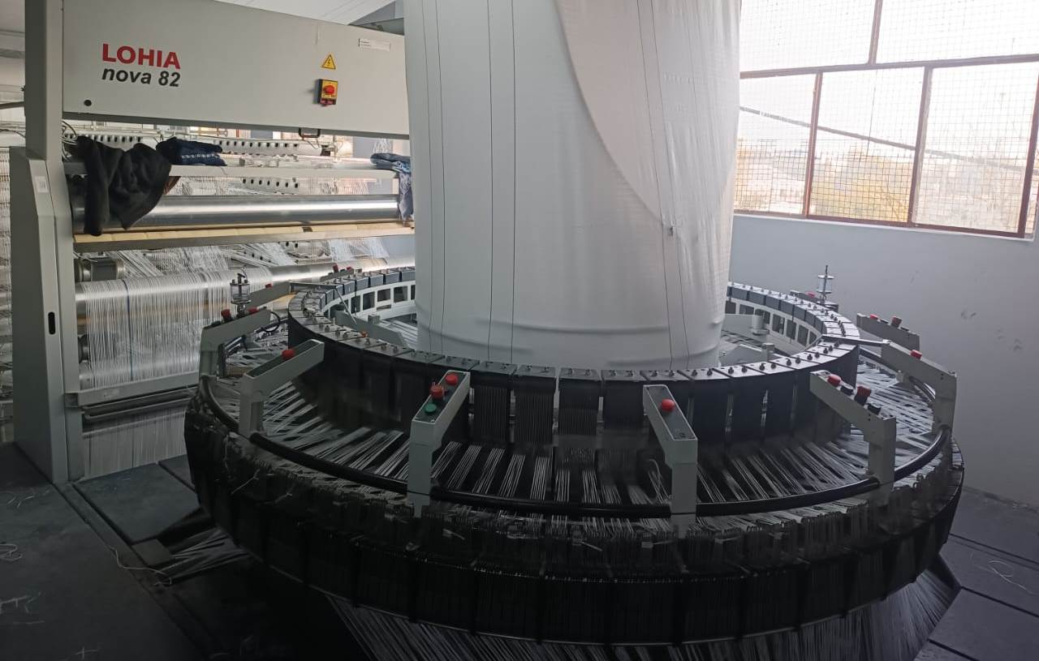
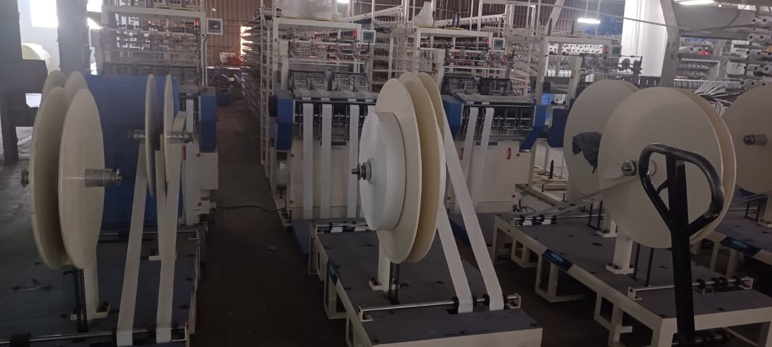
Machinery Installed for FIBC
Tape Plant
Circular Looms
Needle Looms

Slide 12
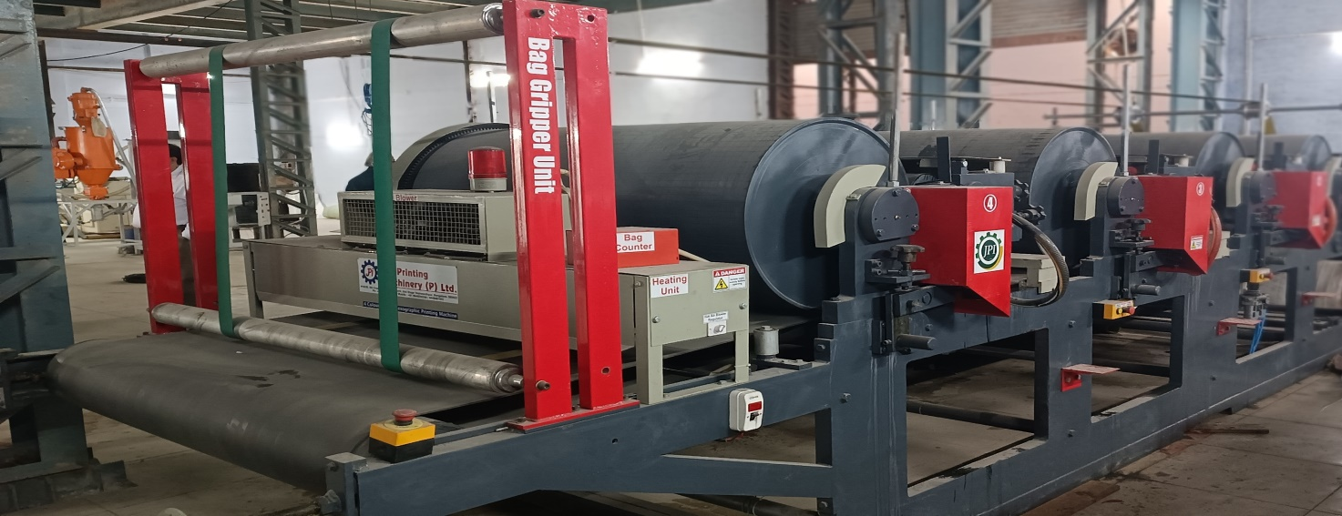
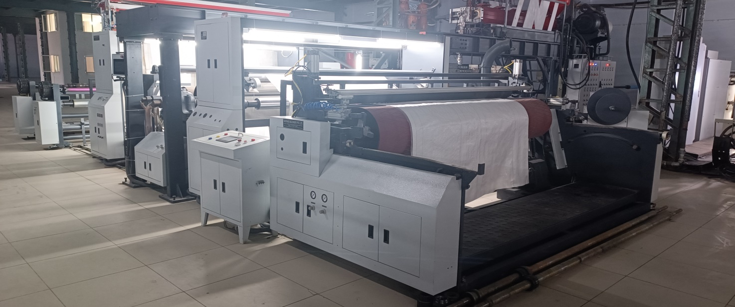
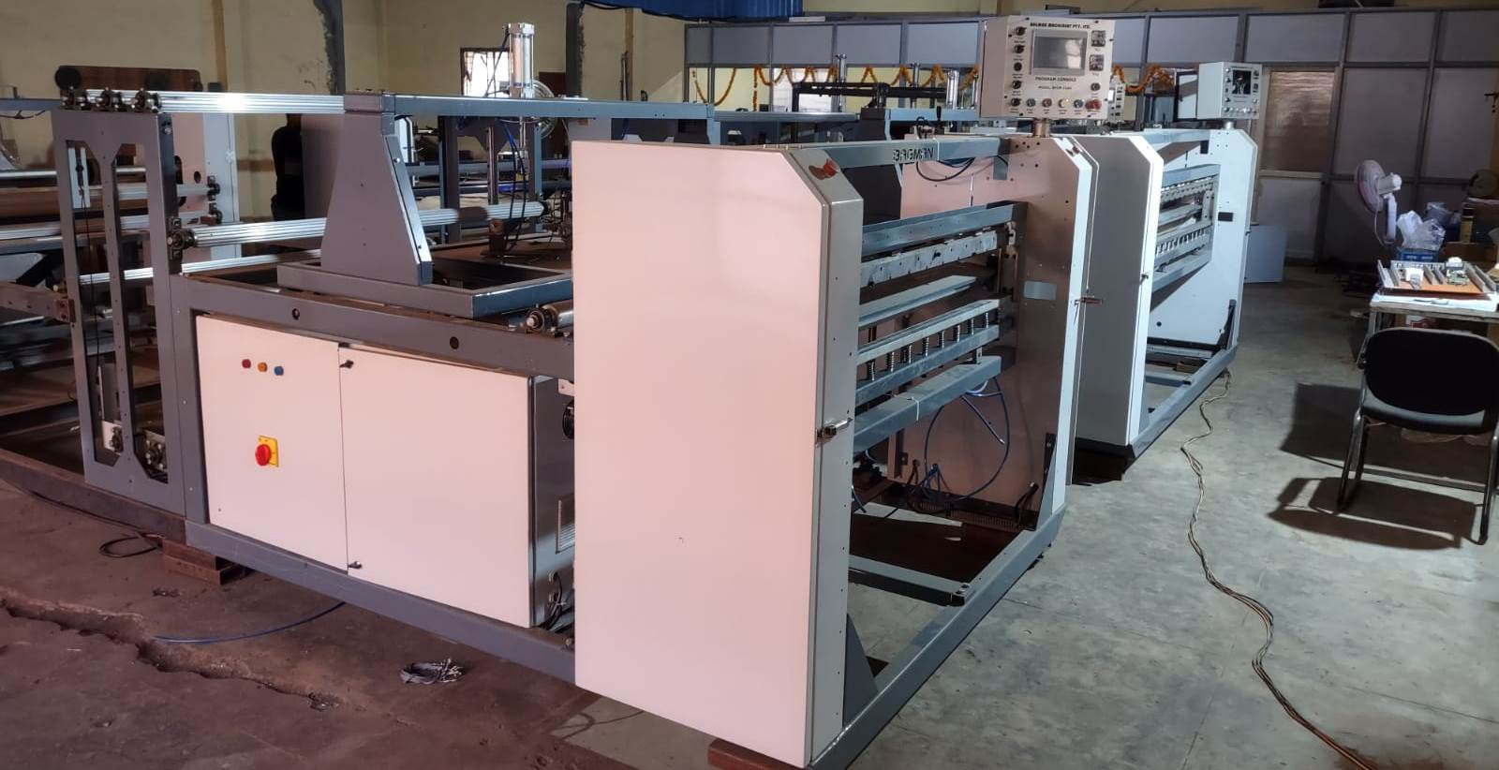
Four Colours Printing Machine
Lamination Machine
Fabric Cutting Machine

Slide 13
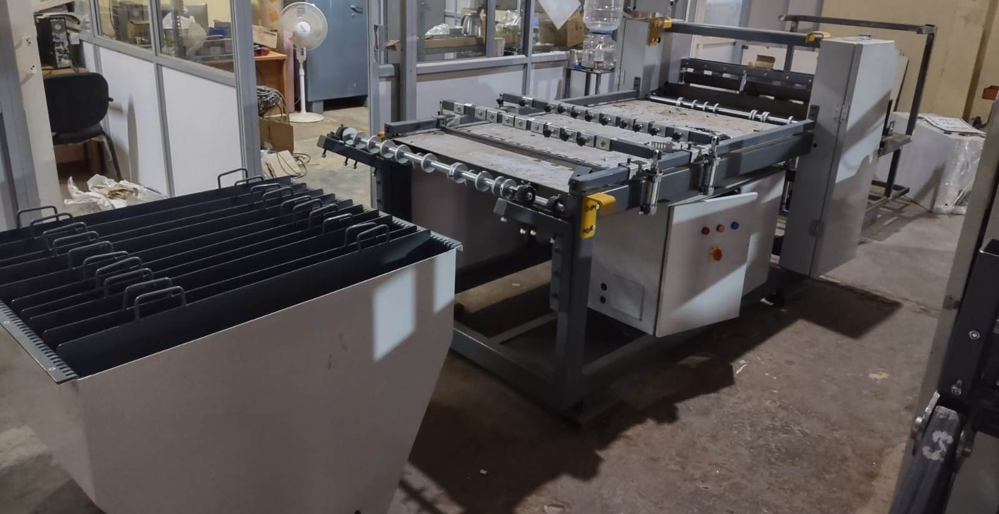
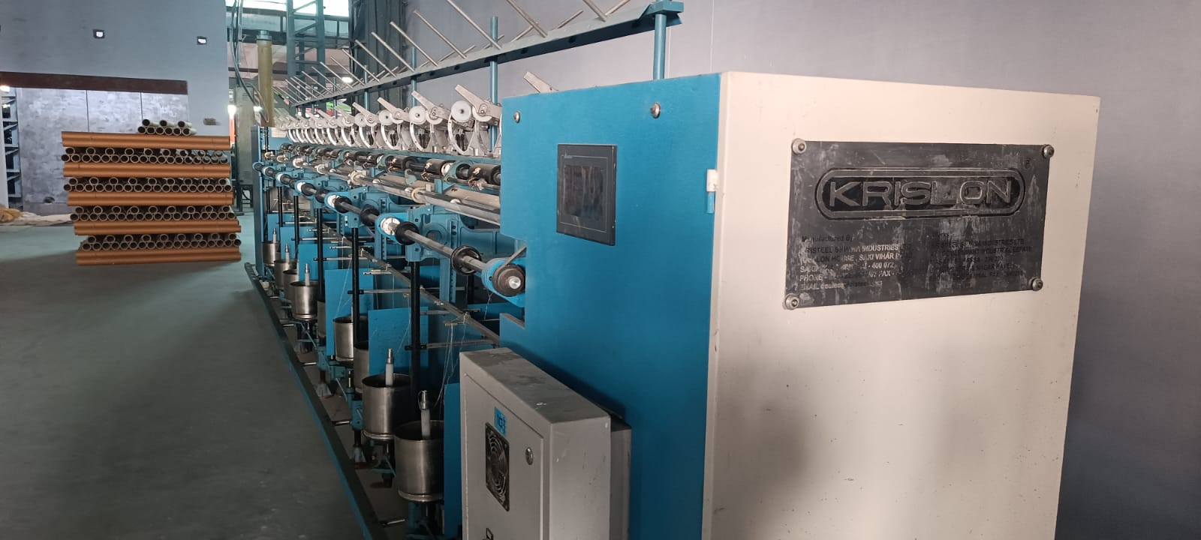
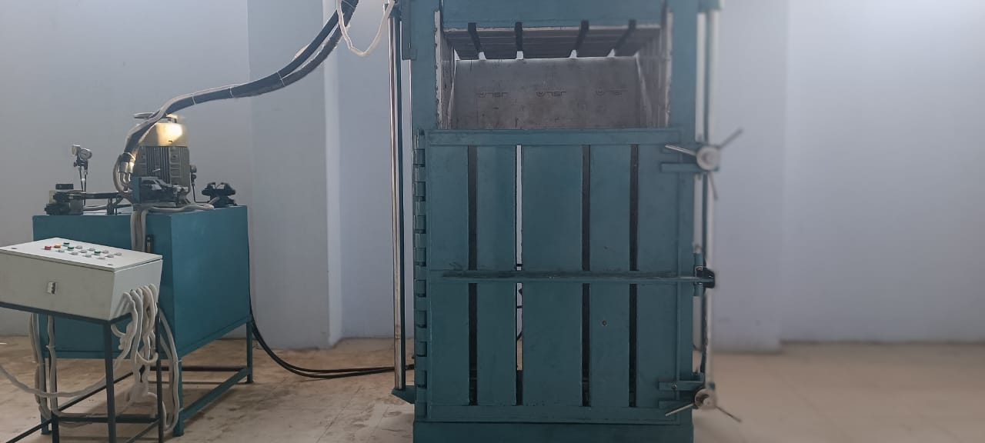
Belt Cutting Machine
Twisting Machine
Bale Press

Slide 14
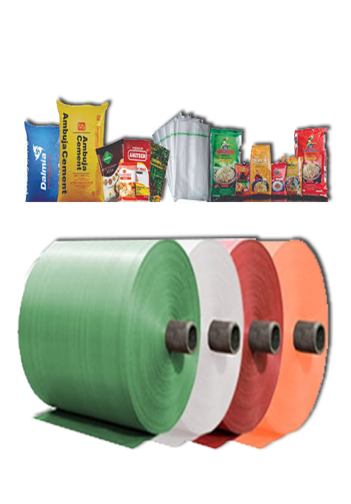
PP Woven Fabric & Sacks

Slide 15
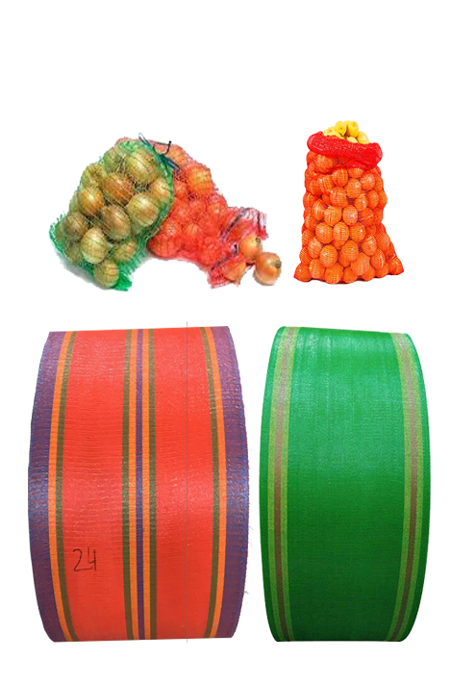
PP Leno Fabric & Sacks

Slide 16
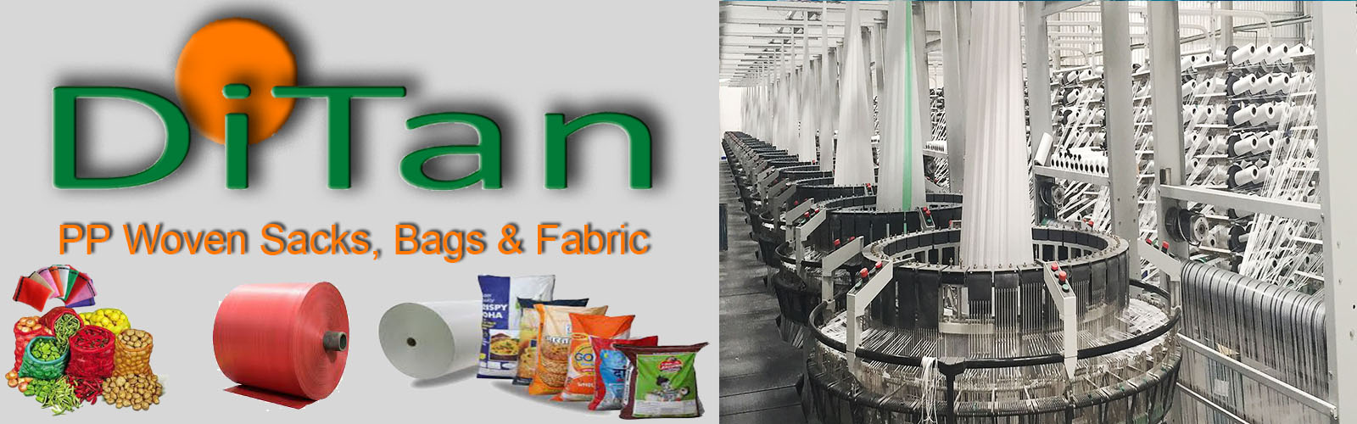
PP Woven Fabrics, Sacks & Bags
We manufacture Flat / Circular PP (Poly Propylene) fabrics for converting into packaging, sheltering & covering products. The Fabrics is available in Laminated and non-laminated form through our in-house lamination facility. Product can be available in below mentioned specifications.
Common Features:
  PP (Poly Propylene) materials.
  Available in Tube & Open Flat Fabrics Roll/Bags forms.
  Fabrics available in coated as well as uncoated forms.
  Perfect for meeting the demands of packaging, sheltering & covering of products
Width | : | Circular Form - 25 cms to 150 cms (10” to 60”) Open Flat Form - 50 cms to 300 cms (20” to 120”)
Length | : | Available in ROLL form.
 | : | Inner. Ø - 80 mm and above.
 | : | Outer Ø - Minimum 1100 mm and above as per requirement.
Mesh | : | 4x4 to 16x16.
Denier | : | 350 Denier to 2000 Denier and above
Weight | : | 30 GSM to 140 GSM and above.
Lamination | : | 12 Micron to 50 Micron and above (10 GSM to 48 GSM)
UV Stabilization | : | Yes (if Required) – 200 Hrs to 1600 Hrs.
Printing | : | One side – One / Two / Three colors, Both side – One / Two / Three colors.

Slide 17
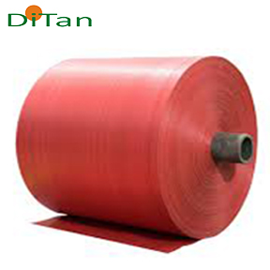
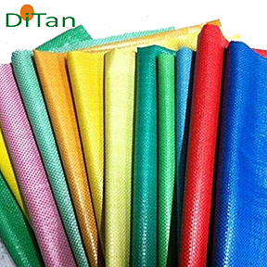
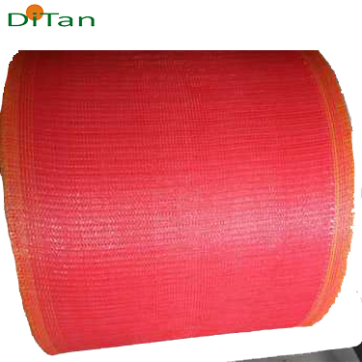
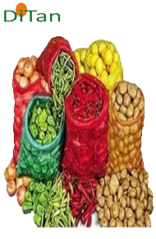
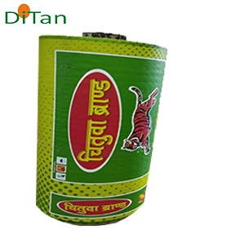
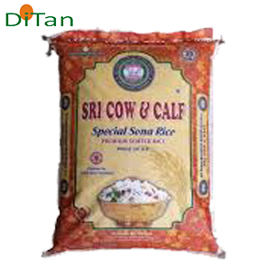
PP Woven Colours Fabric Rolls & Bags
PP Woven Leno Fabric Rolls & Bags
PP Woven Bopp Fabric Rolls & Bags

Slide 18
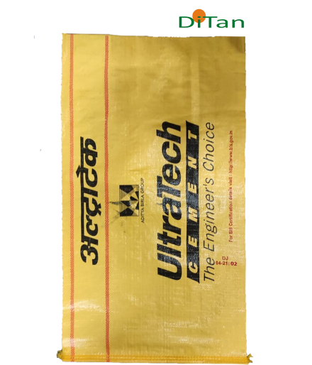
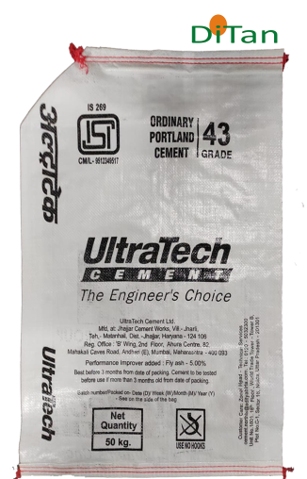
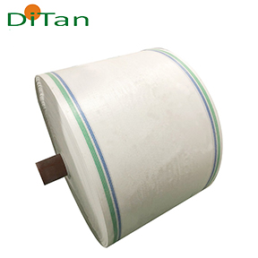
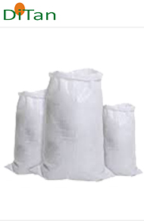
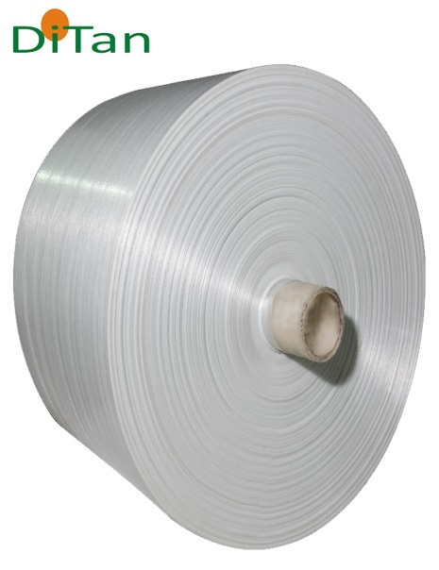
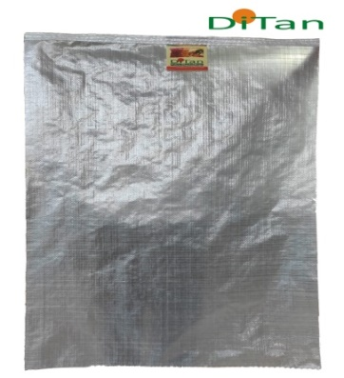
Product Range
PP Woven Cement Bags
PP Woven Milky Fabric Rolls & Bags
PP Woven Natural Fabric Rolls & Bags

Slide 19
Machinery Installed for Woven Fabric & Sacks
Sr. | Machine Description | Nos
1 | Tape Plant - Lorex E120B 1600 HS Tape Extrusion Plant (600Kg/Hour) | 1
2 | Circular Loom - LSL 6 | 13
3 | Circular Loom - Nova 6 | 25
4 | Circular Loom - Leno 4 | 12
5 | Circular Loom - LSL 610 Jumbo | 9
6 | Cheese Winders attached with Tape Plant | 348
7 | UPS 200 KVA | 2
8 | Stitching Machine | 6
9 | Gusset Machine | 1
10 | BCS Machine | 1
11 | Bag Stitching Machine - Valvomatic | 1
12 | Printing Machine - 6 Colours | 1
13 | Bale Press - (40 Ton) | 1
14 | Digital Tensile Testing Machine | 1
15 | Muffle Furness | 1
16 | M.F.I Testing Machine | 1
17 | Warp Reel | 1
18 | Lamination Plant | 1
19 | Generator 600 KVA | 1
 | Generator 380 KVA | 2
 | Generator 320 KVA | 1
20 | Chilling Plant | 1
21 | Cooling Tower 120 TR | 1

Slide 20
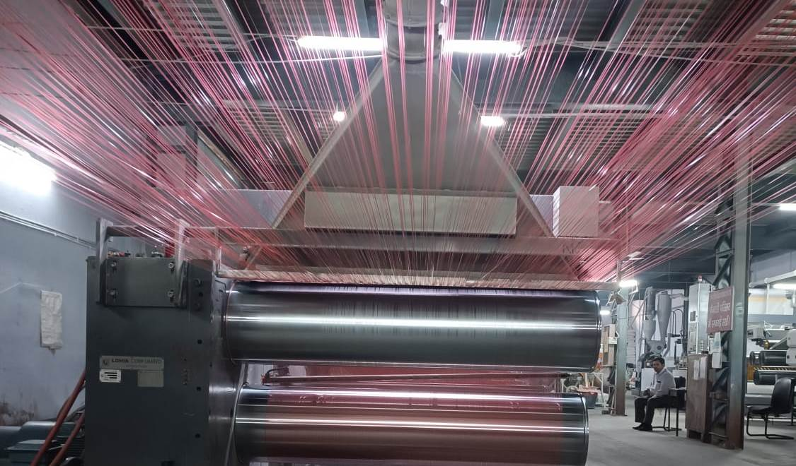
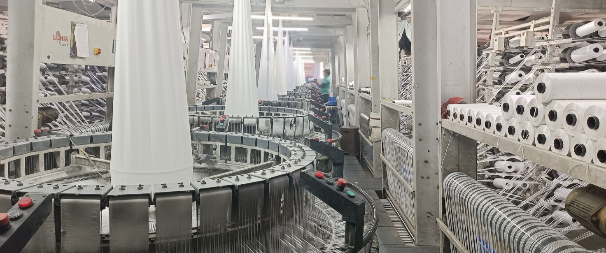
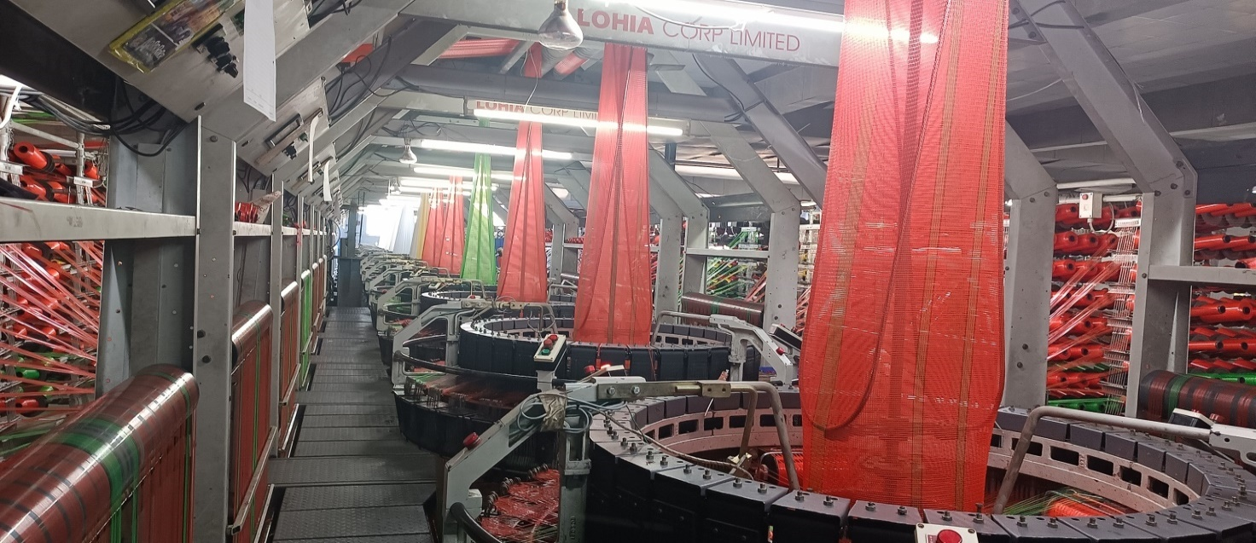
Machinery Installed for Woven Fabric & Sacks
Tape Plant
Nova Looms
Leno Looms

Slide 21
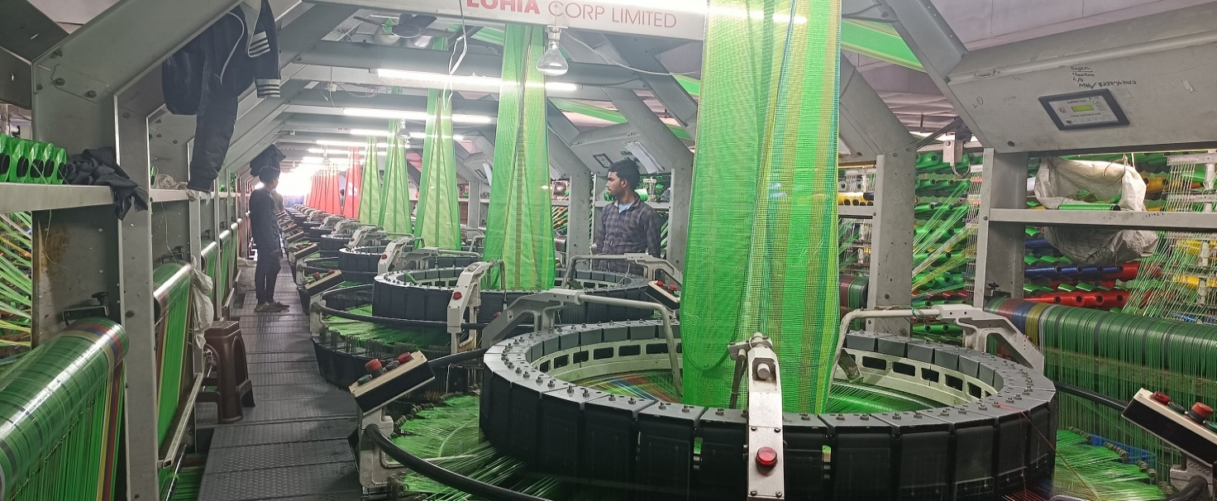
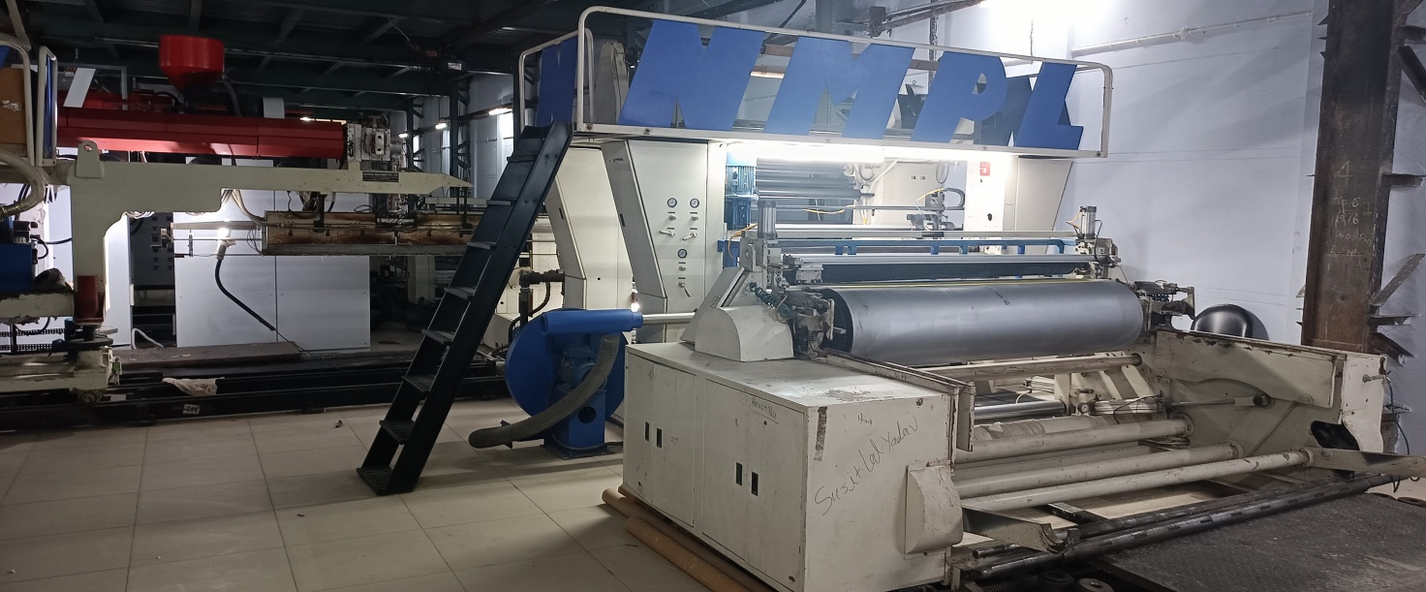
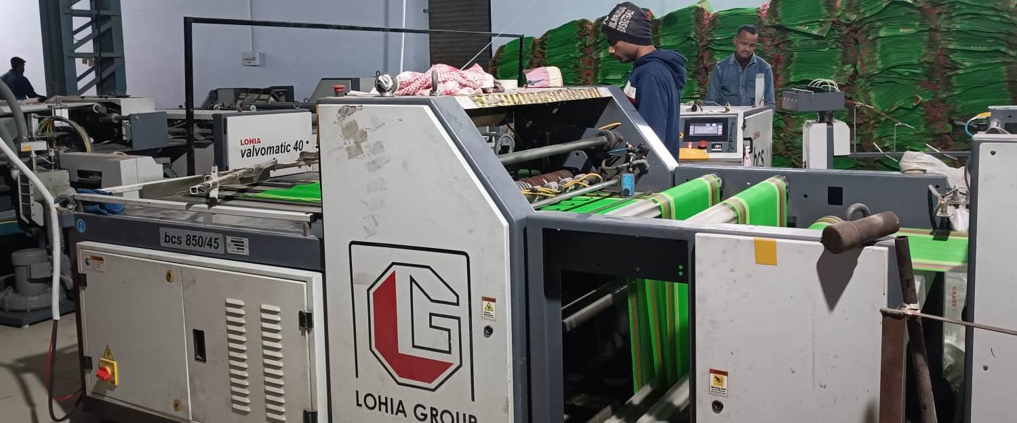
Leno Looms
Lamination Machine
BCS Machine

Slide 22

Calcium Filler Master Batch
For
PP Raffia and
PP Nonwoven Fabric

Slide 23


Thank You
Contact Details
Web Links : www.dishajute.com
www.ditan.in
Email Address : hitesh@dishajute.com
Address : Plot No. 78, Sector 21,
Industrial Area,
Bhiwani, Haryana,
INDIA
ZIP – 127021
G. M. Marketing : Mr. Hitesh Choukse
: +91 97550 09179

